Slide 1

Prepared, Not Afraid
Washington Fields 12th Ward · Preparedness · November 29, 2026
Notes:
Welcome. We have about an hour. This isn't meant to frighten anyone; the goal is the opposite. By the end, every family should know exactly where to go and who to call if something happens, and have two or three small, specific things to do this week.
Point people to the ward website now if they have phones out: ward-preparedness.vercel.app. Everything in this lesson is there.

Slide 2

Why we prepare
From the Utah Area Presidency
“If ye are prepared ye shall not fear.”
Doctrine and Covenants 38:30
Their recent letter invites wards to strengthen preparedness. It is not a new program, and not a warning of anything imminent: just thoughtful, ongoing preparation as we care for one another.
“Prepare every needful thing.”
Doctrine and Covenants 88:119
Notes:
Read D&C 38:30. The promise is peace, not panic.
This lesson was prompted by the Utah Area Presidency's letter to stake and ward leaders. Paraphrase it: they invite us to strengthen preparedness, financial, food and water storage, emergency planning, emotional resilience, and being able to help others. They were careful to say this isn't a new program and isn't a sign that something is about to happen. It's steady, ongoing preparation.
If you have the letter, you may want to read its last paragraph aloud.

Slide 3





Preparedness is more than food storage
Finances
Food & water
Emergency plan
Emotional resilience
Helping others
A small reserve, then more
What we'd live on
Where to go, who to call
Steady hearts and homes
Ready to serve, not just survive
Notes:
These five areas come straight from the Area Presidency's letter. Notice that food storage is only one of them.
Today we'll spend most of our time on the emergency plan and on food and water, because those are the most concrete. We'll also talk about what happens if the income stops, which is the emergency most of us are likeliest to face, and about emotional resilience, and close with helping each other, which is the part only a ward can do.

Slide 4
Today
1
Our risks
What could actually happen here
8 min
2
The first hour
Our ward plan, step by step
12 min
3
Water & food
How much, how to store it
15 min
4
Kits, power & money
Go-bags, outages, if the income stops
12 min
5
Helping each other
Skills, needs, and next steps
10 min
Notes:
Five parts, about 57 minutes, leaving a few minutes for questions at the end. If discussion runs long in part 2 or 3, shorten the kit and outage slides, since that content is on the website. Try not to cut the money slides.

Slide 5
What could actually happen here
Part 1
Notes:
Every area has its own risks. Ours are not the same as Salt Lake's: less snow, more heat and flash floods.

Slide 6








Our hazards in Washington Fields
Most years
Less often, but serious
Extreme heat (105°F+)
Earthquake (Hurricane Fault)
Flash floods (monsoon season)
Virgin River flooding
Wildfire and smoke
Dam or dike failure upstream
High wind and dust storms
Landslides and rockfall
Drought and water limits
Long power outages
Notes:
Left side: things that happen to someone in Washington County most years. Heat is the deadliest of these, especially when the power goes out. Flash floods come with the July-to-September monsoon storms, sometimes from storms miles away.
Right side: rarer, but they affect everyone at once. Ask: who here was living in the area in 1989? That leads into the next slide.
Optional discussion question: Which of these has your family actually experienced?

Slide 7

It has happened here
1,500
The lesson
It came at night, on a holiday, with no warning
Families had minutes, not hours
The ones who did best already knew where they'd go
people forced from their homes
January 1, 1989: the Quail Creek Dike failed just after midnight. A wall of water crossed the farmland, poured into the Virgin River, and washed out roads and bridges downstream.
Notes:
The Quail Creek Dike failed at about 12:30 a.m. on New Year's Day, 1989. About 1,500 people had to leave their homes, and damage ran over $12 million. Washington Fields sits in the Virgin River valley, downstream of Quail Creek and Sand Hollow reservoirs.
The dike was rebuilt and this isn't a reason for fear. It's a reminder that emergencies here don't come with an appointment. If any longtime members remember that night, invite them to share for a minute.
Sources: Association of State Dam Safety Officials case study; USGS report on the January 1989 Virgin River flood.

Slide 8
Earthquake: the one that hits everyone at once
The Hurricane Fault runs just east of us.
In 1992, a magnitude 5.8 earthquake near St. George set off a large landslide in Springdale. A stronger quake is possible.
Phones
Power & water
Roads & bridges
Help
may be jammed for hours
may be off for days
may be closed
starts with neighbors
Notes:
The September 2, 1992 St. George earthquake (magnitude 5.8) triggered the Springdale landslide that destroyed several homes. The Hurricane Fault is one of Utah's major faults.
The key point: in a big earthquake, official responders will be overwhelmed. For the first hours, maybe the first days, help comes from family and neighbors. That's why the ward plan in Part 2 is built around checking on each other.

Slide 9




Heat: our most common danger
105°F+
Most at risk
Older members and anyone living alone
a normal summer afternoon here
Anyone on oxygen, CPAP, or other powered equipment
When the power goes out in July, a house can become dangerous within hours.
Medications that need refrigeration
Infants and young children
Notes:
Heat doesn't make the news the way an earthquake does, but it's the hazard most likely to hurt someone in our ward.
Ask everyone to think of one person on their street who would be in trouble in a summer outage. Those are the people we want to know about, and the Skills & Needs form at the end is how leaders will know.

Slide 10
The first hour: our ward plan
Part 2
Notes:
This is the most important part of the lesson. If people remember only one thing, it should be what to do in the first hour, and where to gather.

Slide 11
After an earthquake: the first hour
1
Drop, cover, hold on
until the shaking stops
5
Check on neighbors
especially anyone alone
2
Check your household
for injuries; give first aid
6
Report or gather
text your contact, or come to the meetinghouse
3
Check for hazards
gas only if you smell it or hear hissing
7
Listen for updates
KDXU 890 AM or NOAA 162.475
4
Put up your sign
OK or HELP in the front window
Notes:
Walk through each step. A few details worth saying out loud:
3: Don't shut off the gas just in case. Only if you smell gas or hear hissing; once it's off, only the gas company can turn it back on, and that can take days or weeks after a big quake.
6: Text instead of calling. Texts often get through when calls don't.
7: KDXU 890 AM is the St. George area's primary emergency alert station. NOAA Weather Radio for St. George is 162.475 MHz.
This list is on the website and on the printable sheet.

Slide 12
Put your sign in the front window
OK
HELP
Everyone is accounted for and safe.
We need help: injury, damage, or someone missing.
Notes:
This is how one person can check a whole street in a few minutes without knocking on every door. Green means skip us; red means stop here first.
No sign means we don't know, so someone should knock.
Challenge: make your two signs this week (a sheet of paper and a marker works) and keep them somewhere you can find them in the dark, like with your 72-hour kit or taped inside a closet door.

Slide 13

Where to gather
EVERYONE
The meetinghouse parking lot on Log Lane
BACKUP, IF THE MEETINGHOUSE IS UNSAFE
near 251 W 2000 S
The grass field with the pavilion and swing set
Wait outside in the open, away from buildings and power lines. Leaders will check here first.
20 East, between Primrose and Orchard Lanes, by the stone “Fields” sign
Notes:
One gathering point for the whole ward: the meetinghouse parking lot on Log Lane. Wait outside, not in the building, after an earthquake.
If the meetinghouse isn't safe (fire, damage, flooding), the backup is the grass field with the pavilion on 20 East.
Ask: does every family know how they'd get to the meetinghouse on foot? After an earthquake, driving may not be possible.

Slide 14



One exception: if officials say shelter
Get inside
Stay inside
Stay tuned
A sturdy building, with doors and windows closed
The gathering point waits until officials say it's safe
KDXU 890 AM or NOAA 162.475, and text your contact
Notes:
This is the one time the gathering plan doesn't apply. If officials order people to shelter in place, usually because the air outside may be dangerous, stay inside instead of coming to the meetinghouse.
Keep this calm and short. It's one rule added to the plan you already have, and the water, food, and radio you've stored are what make it possible to stay home.

Slide 15

Who to contact
Ward emergency preparedness
Steve Doughty
(435) 619-7769
Bishop
Scott Bushar
(435) 705-1065
Pick an out-of-state contact
Elders quorum president
Trey Morris
(435) 705-4402
After a local disaster it's often easier to reach someone far away than across town. Make sure everyone in your family knows their number.
Relief Society president
Andrea Moore
(435) 229-7375
Your first contact is your ministering brother or sister. Save these numbers in your phone today.
Notes:
Pause here and invite everyone to save these four numbers in their phones right now.
The out-of-state contact idea: local phone lines jam, but a call or text to Arizona or Idaho often goes through. Each family member checks in with that one person, who relays messages.
Optional activity: give everyone 60 seconds to decide who their out-of-state contact will be.

Slide 16



Get official alerts on your phone
Text a keyword to
Genasys Protect app
Look up your evacuation zone before you need it.
888777
WASHCOES
General emergency updates
KDXU 890 AM
The area's main emergency alert station.
WASHCOFIRE
Fire updates
NOAA Weather Radio
162.475 MHz (St. George, WWF51)
WCFLOOD
Flood warnings
Notes:
Do this one live: ask everyone with a phone to text WASHCOES to 888777 right now. It takes ten seconds. These keywords come from Washington County Emergency Management.
Genasys Protect is the free app the county uses for zone-based evacuation orders during fires and floods. Look up your zone ahead of time.
KDXU 890 AM is the St. George area's primary station in the Emergency Alert System. A battery or hand-crank radio is a good 72-hour-kit item for when phones and power are down.

Slide 17
Water & food
Part 3
Notes:
Water first, because people can go weeks without food but only days without water, and in our heat, fewer than that.

Slide 18
Water: how much?
1 gallon
A family of four, two weeks
56
per person, per day
gallons
Store two weeks: 14 gallons each
Double it for summer heat
Pets need their own
112
gallons in summer heat
About 11 five-gallon jugs, or two 55-gallon barrels
Notes:
One gallon per person per day covers drinking and basic hygiene. Two weeks is the standard goal: 14 gallons per person.
In our summer heat, people need much more to drink, so double it.
The calculator on the ward website does this math for any family size. We'll look at it in a few minutes.

Slide 19



Storing water
Use food-grade containers
Keep it cool and out of the sun
Commercially bottled water, or new containers made for water. Not milk jugs; they break down.
Away from gasoline, paint, and chemicals, which can seep through plastic.
Rotate tap water you store
Remember your water heater
Replace it about every six months. Write the date on each container.
Its tank holds drinkable water. Turn off its gas or power before draining it.
Notes:
Practical tips. The garage is a poor place for water storage here: summer heat and nearby chemicals. A closet or under a bed works.
Milk jugs are designed to biodegrade and often leak within months, so use containers made for water.
The water heater tip surprises people: a typical tank holds 40 to 50 gallons of drinkable water already in your house.

Slide 20



Making more water safe
Boil
Bleach
Filter
A full rolling boil for 1 minute, then let it cool.
Plain, unscented bleach: 8 drops per gallon (6%) or 6 drops (8.25%). Stir and wait 30 minutes.
A filter rated to remove bacteria and protozoa. Good for any kit.
If the water is cloudy, let it settle and filter it through a clean cloth first. Bleach guidance: U.S. EPA.
Notes:
Stored water runs out; a way to make more water safe is just as important.
The bleach amounts are EPA guidance: for regular 6% bleach, 8 drops per gallon; for the newer concentrated 8.25%, 6 drops. Unscented only. Stir, and wait 30 minutes. It should smell slightly of chlorine; if not, repeat and wait 15 more minutes.
A bottle of unscented bleach and an eyedropper in your kit costs a few dollars.

Slide 21


Food: start with what you eat
Three-month supply
Longer-term basics
The everyday foods your family already eats
Buy a little extra each shopping trip
Use it and rotate it: first in, first out
Wheat, white rice, oats, beans
Keep 20 to 30 years when packaged well
Add over time, as you're able
Build the three-month supply first. Never go into debt for food storage.
Notes:
This follows the Church's guidance on providentliving: build a three-month supply of foods you normally eat first, then add longer-term basics as you're able.
The three-month supply is the one families actually use: job loss, illness, a long outage. It's just your normal pantry, deeper.
Emphasize 'a little at a time.' Nobody is asked to go into debt for food storage.

Slide 22

One year of basics for one adult
Planning estimates, not requirements
Children need less. Plus about 10 quarts of cooking oil. The ward calculator scales this to your family and any length of time.
Notes:
These are common food-storage planning figures for one adult for a full year. They're estimates, not commandments, and the Church's current guidance doesn't set exact amounts.
A year is a long-term goal. Three months of everyday food comes first.
On the website calculator, children 4 to 11 count as about 70 percent of an adult, little ones about half.

Slide 23

Heat is food storage's enemy
Not in the garage
Summer garages here can pass 120°F. Heat cuts shelf life sharply and ruins taste and nutrition.
Cooler storage means food that lasts years longer.
Store it inside: a closet, under beds, a cool room
Keep it dry, dark, and off the floor if it might flood
Date everything; use the oldest first
Notes:
This is a big one for southern Utah. A lot of food storage gets ruined in hot garages and sheds.
As a general rule, the hotter food is stored, the faster it loses quality. Food stored near 70°F lasts far longer than food stored at 90°F or more.
Ask: where could your family fit food storage inside the house? Under beds and the backs of closets are common answers.

Slide 24
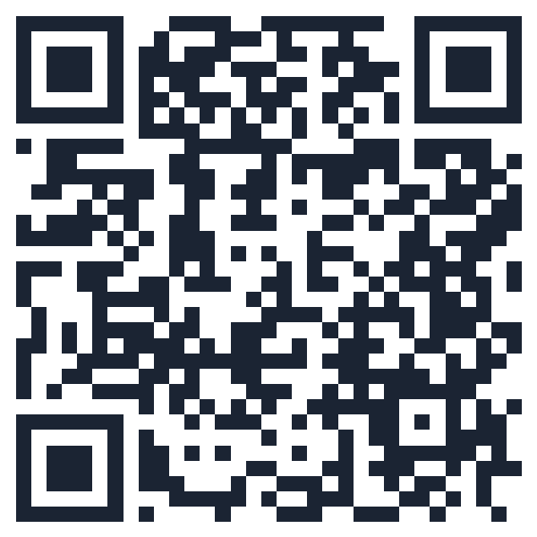


Try the ward calculator
Enter your family and how long, and it shows:
Gallons of water, in jugs or barrels
Meals and calories needed
Pounds of grains, beans, and other basics
Scan with your phone's camera
ward-preparedness.vercel.app
Notes:
If the room has Wi-Fi or good signal, demo it live: enter a family of four for three months and show the water, meals, and basics.
Then invite everyone to scan the code and try their own family. It's private: nothing they enter is saved or sent anywhere.

Slide 25
Kits, power & money
Part 4
Notes:
The kit and outage slides can go quickly, since they're on the Church's preparedness pages and the website. Give the money slides their full time.

Slide 26








A 72-hour kit for each person
Water
Ready-to-eat food
First aid kit
A week of medications
Flashlight
Battery or crank radio
Phone charger, power bank
Copies of IDs and documents
Cash in small bills
Clothes and sturdy shoes
Hygiene items
Something comforting for kids
Notes:
A 72-hour kit is a go-bag: what you'd grab if you had five minutes to leave because of a fire or flood. One per person, in a backpack each person can carry.
The items people forget most: medications, glasses, copies of documents, phone chargers, and cash, since card readers don't work in an outage.
Ready.gov/kit has a printable checklist, linked from the ward website.

Slide 27

Plan for a summer power outage
Every household
If someone depends on power
Know where you'd go to stay cool
Extra water and a battery fan
Coolers and ice for food and medicine
Never run a generator or grill indoors or in the garage
Oxygen, CPAP, dialysis, refrigerated medicine
Ask your provider about backup batteries
Tell the ward on the Skills & Needs form so we know to check on you
Notes:
This is our most likely emergency. Generators cause carbon monoxide deaths every year when run in a garage, even with the door open.
The right column is the reason the Skills & Needs form exists. If someone in your home depends on electricity for their health, the ward leaders want to know so someone checks on you first.

Slide 28



If the income stops
The most likely emergency in this room isn't an earthquake.
Less debt
Lower monthly costs
Savings
A second way to earn
Fewer payments when the paychecks stop
Your money lasts longer
Time to find the right next job
Somewhere else to turn
FIRST STEP
FIRST STEP
FIRST STEP
FIRST STEP
Pay off your smallest debt
Lower one monthly bill
Save one month of basics, plus some small bills at home
Take a class, learn a trade, or try side work
Notes:
The Area Presidency named wise financial practices first in their letter. A job loss or medical bill is far more likely than an earthquake, and nobody calls 911 when the income stops.
The Church's guidance is simple: pay tithing, avoid debt, use a budget, and build a reserve a little at a time. The first steps here are deliberately small. Some families are already behind, so this is a direction to head, not a standard to meet.
The second way to earn is the one people tend to overlook. Jobs are changing quickly, and a young family can start on this with very little money.
Optional, if you're comfortable sharing your own experience: focus on the peace rather than on what you own. "If I lost my job, it wouldn't be a disaster, and I want that peace for every family here." It was built over time.

Slide 29


If it happens: the first week
Talk to the bishop early
No shame in it, and it stays confidential
How the ward can help
Apply for unemployment
And list the bills that must be paid
Pass along job leads
Review a résumé
Practice interviews
Eat from your pantry
That's what it's for
Add it under “Other” on the Skills & Needs form.
Tell people you're looking
Many jobs come through someone you know
Notes:
People will tell you their roof is damaged long before they'll say they lost their job, and a ward can't help with what it doesn't know about. Say out loud that there's no shame in this.
The food storage we just talked about is also a job-loss plan. Every meal from the pantry is money you don't have to spend.
The right side costs nothing and may help more than anything else on this slide. The Church also has self-reliance courses on personal finances and finding a better job, linked from the ward website.

Slide 30


Emotional and spiritual resilience
“Be still, and know that I am God.” Psalm 46:10
Keep spiritual habits
Talk with your kids
Stay connected
Prayer and scripture steady us when routines break.
Practice the plan calmly so it feels familiar, not scary.
Isolation makes everything harder. Check in on each other.
Notes:
The Area letter specifically names emotional resilience. Stored food doesn't help much if fear takes over.
For children, practicing the plan (where we'd meet, what the signs mean) turns an unknown into something familiar.
This is a good place for a brief personal testimony about peace that comes from being prepared.

Slide 31
Helping each other
Part 5
Notes:
The part only a ward can do. FEMA can't know who on our street uses oxygen. We can.

Slide 32
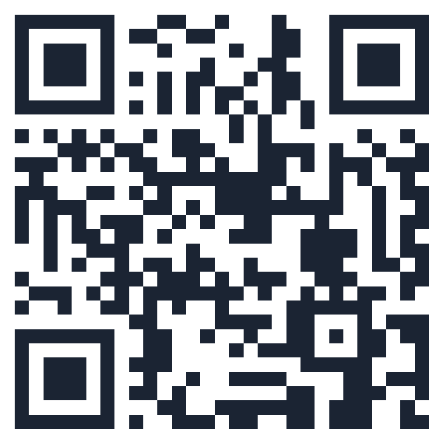

Share your skills or needs
Skills & resources
Needs
Medical training, ham radio, chainsaw, generator, trailer, trades, childcare, languages
Mobility limits, powered medical equipment, living alone, no vehicle
Seen only by ward leaders
forms.gle/gZVnFFsvJEUMPPtM8
Notes:
One form per household, about five minutes. Skills tell us who can help; needs tell us who to check on first.
Privacy matters here: only the bishopric and the emergency preparedness leaders see the answers. Needs are never posted anywhere. You can ask to update or remove your information any time.
Invite people to scan and fill it out right now, or tonight at home.

Slide 33
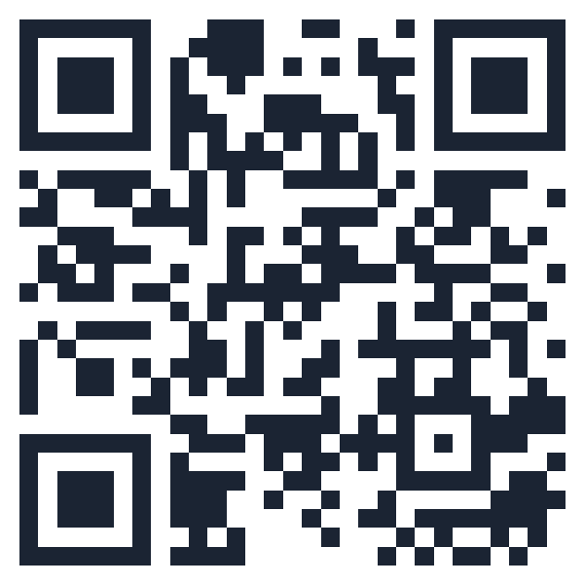



Take the preparedness survey
Anonymous
No names, no addresses.
About 3 minutes
A dozen quick questions.
Shapes what comes next
Your answers tell leaders which classes and group buys would help most.
forms.gle/j41nPV3mEBQNdYiw7
Notes:
This one is anonymous, so be honest. 'Not yet' is a perfectly good answer.
The last question asks what would help most: classes on water or food storage, help building kits, group purchases. Leaders will use the combined answers to plan the next few months.
If you'd like, report the results back in a future sacrament meeting or newsletter.

Slide 34



Start this week
Text WASHCOES to 888777
Ten seconds. Official county alerts.
Fill out both forms
Skills & needs, and the anonymous survey.
Store one case of water
Or add one extra item each shopping trip.
Everything from today:
Save the four numbers
And choose your out-of-state contact.
ward-preparedness.vercel.app
Notes:
Close with small, specific actions. Small and simple things. Nobody leaves feeling they need to buy a year of food tomorrow.
The website has everything from today: the plan, the contacts, the calculator, the forms, and a printable one-page version for the fridge.

Slide 35
If ye are prepared
ye shall not fear
Doctrine and Covenants 38:30 · Questions?
Notes:
Return to the opening scripture. Bear testimony of the peace that comes from following the Lord's counsel to prepare, and of the strength of a ward that looks after one another.
Open for questions with whatever time remains.

